Slide 1
Consonant Blends
Let’s Go To The Farm
And here your subtitle.

Slide 2
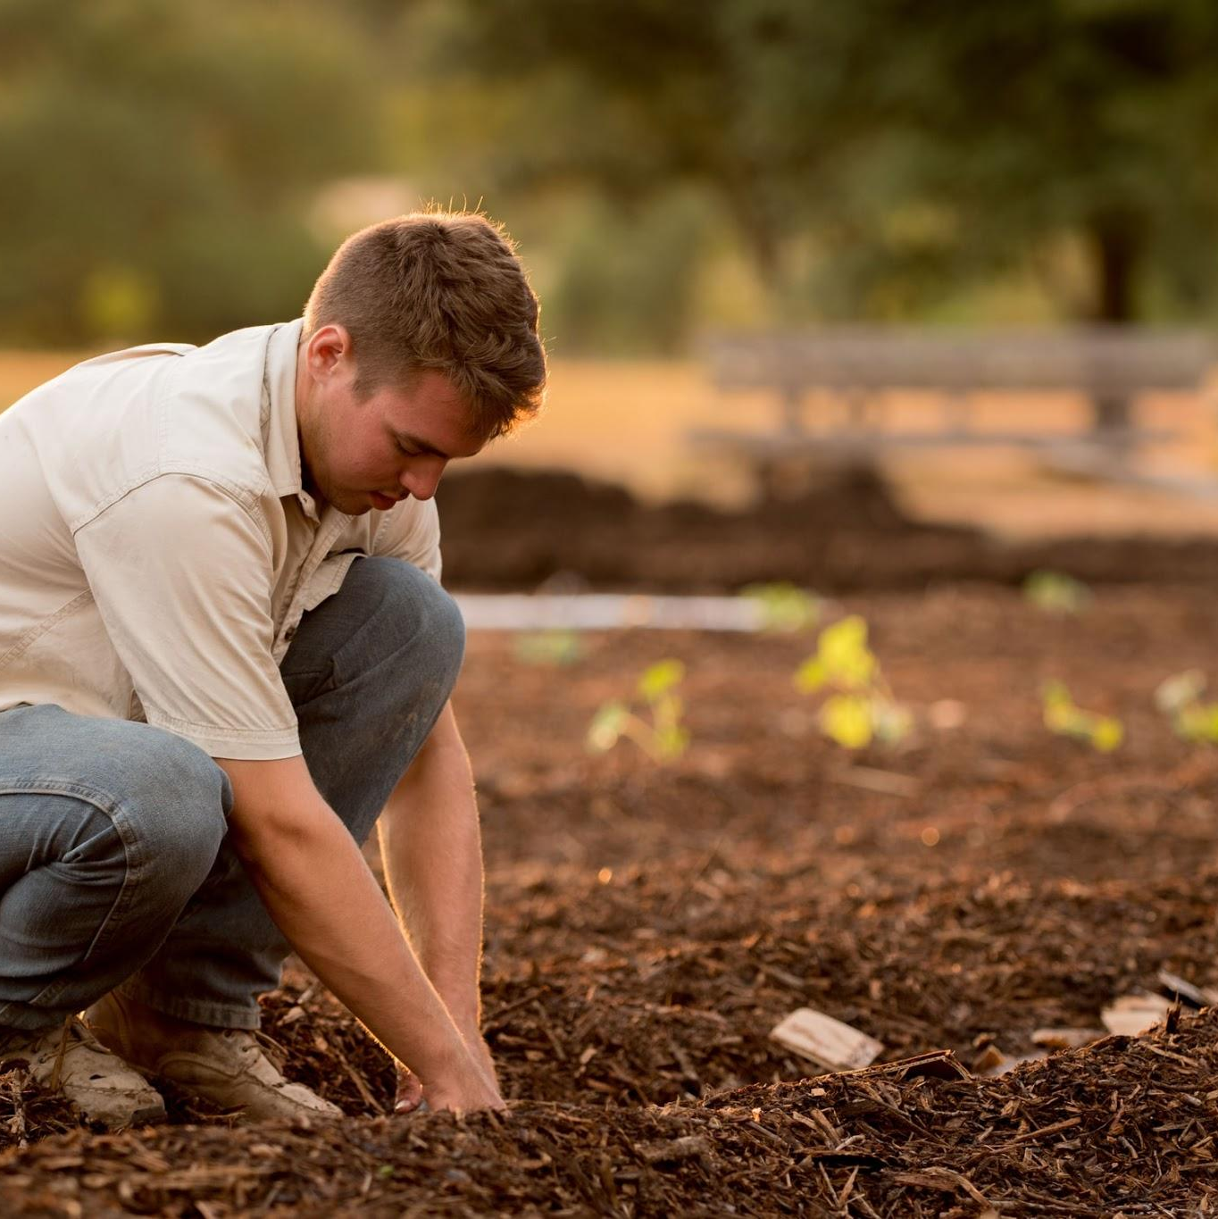
Sounds warm up!
Notes:
Teacher includes Phonological warm up based upon student needs:

Slide 3
Vowels warm up!
e u o a i e u o
via Alex Phillip on GIPHY

Slide 4
Vowels warm up!
e u o a i e u o
via Alex Phillip on GIPHY

Slide 5
Vowels warm up!
e u o a i e u o
via Alex Phillip on GIPHY

Slide 6
Vowels warm up!
e u o a i e u o
via Alex Phillip on GIPHY

Slide 7
Vowels warm up!
e u o a i e u o
via Alex Phillip on GIPHY

Slide 8
Vowels warm up!
e u o a i e u o
via Alex Phillip on GIPHY

Slide 9
Vowels warm up!
e u o a i e u o
via Alex Phillip on GIPHY

Slide 10
Vowels warm up!
e u o a i e u o
via Alex Phillip on GIPHY

Slide 11
Vowels warm up!
e u o a i e u o
via Alex Phillip on GIPHY

Slide 12
Consonants and digraphs review...
j th ch h wh sh qu l r y

Slide 13
Consonants and digraphs review...
j th ch h wh sh qu l r y

Slide 14
Consonants and digraphs review...
j th ch h wh sh qu l r y

Slide 15
Consonants and digraphs review...
j th ch h wh sh qu l r y

Slide 16
Consonants and digraphs review...
j th ch h wh sh qu l r y

Slide 17
Consonants and digraphs review...
j th ch h wh sh qu l r y

Slide 18
Consonants and digraphs review...
j th ch h wh sh qu l r y

Slide 19
Consonants and digraphs review...
j th ch h wh sh qu l r y

Slide 20
Consonants and digraphs review...
j th ch h wh sh qu l r y

Slide 21
Consonants and digraphs review...
j th ch h wh sh qu l r y

Slide 22
wet mug yum net rid
shop ship chin chum rich
when whip then this moth
― Irene M. Pepperberg

Slide 23
jet run yam nod gas
cash wish dish chug chop
wham then bath with math
― Irene M. Pepperberg

Slide 24
Consonant Blends
I
slam slip slug slap flip flop
brag brim drop drum prod
grip grab trip tram truck
stick stuck stem stop step
.

Slide 25
Let’s talk about the r control vowel ….
I
What do we call this ?
a star!
.
Notes:
Teacher: Introduce r-controlled vowel /ar/ Words: star, car, barn farm,

Slide 26

R control intro….
I
What do we call this ?
a car!
.

Slide 27
R control intro….
I
What do we call this
red building?
a barn!
.

Slide 28
R control intro….
I
Where is the barn?
On a farm!
.

Slide 29
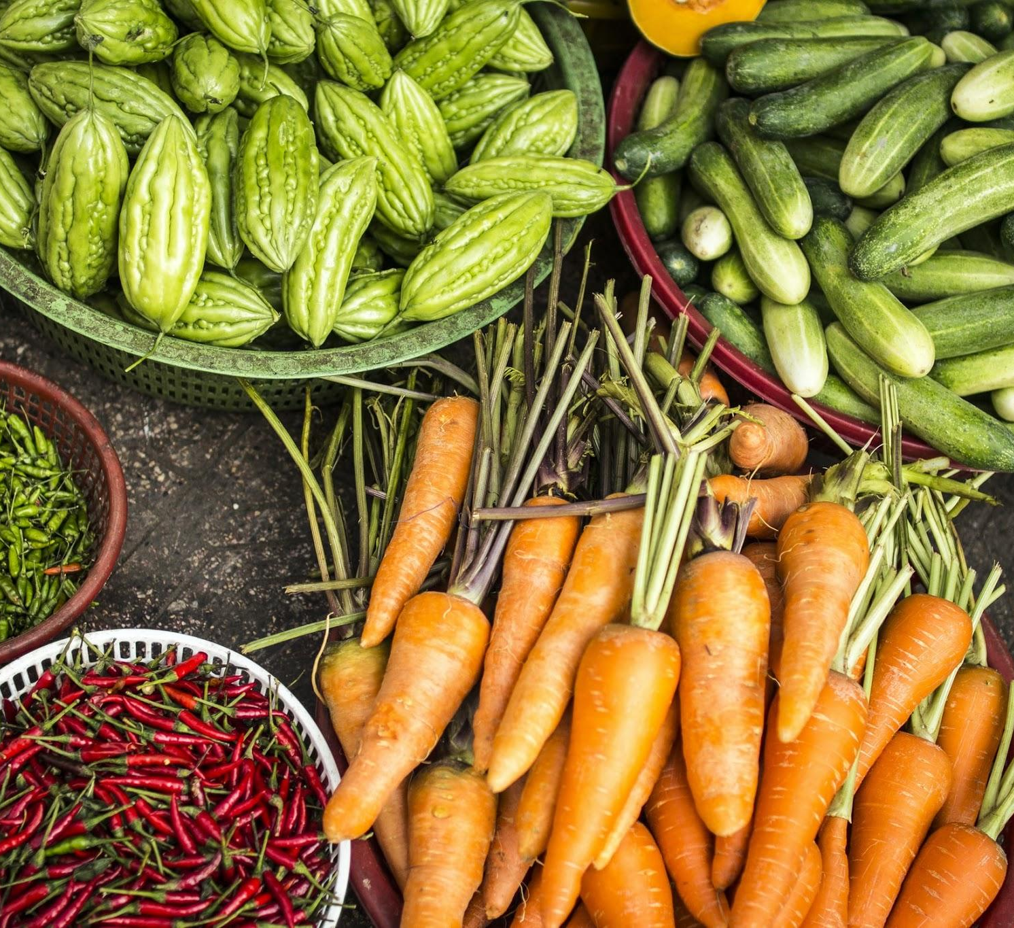
Let’s Read
Big Words (multi-syllabic words)
Is there an affix? (-s,-es, -ing -ed)
Look for the vowels.
Is there a “e” (magic e)
Is there an “r” (r-control)
Is the vowel sound short or long?

Slide 30
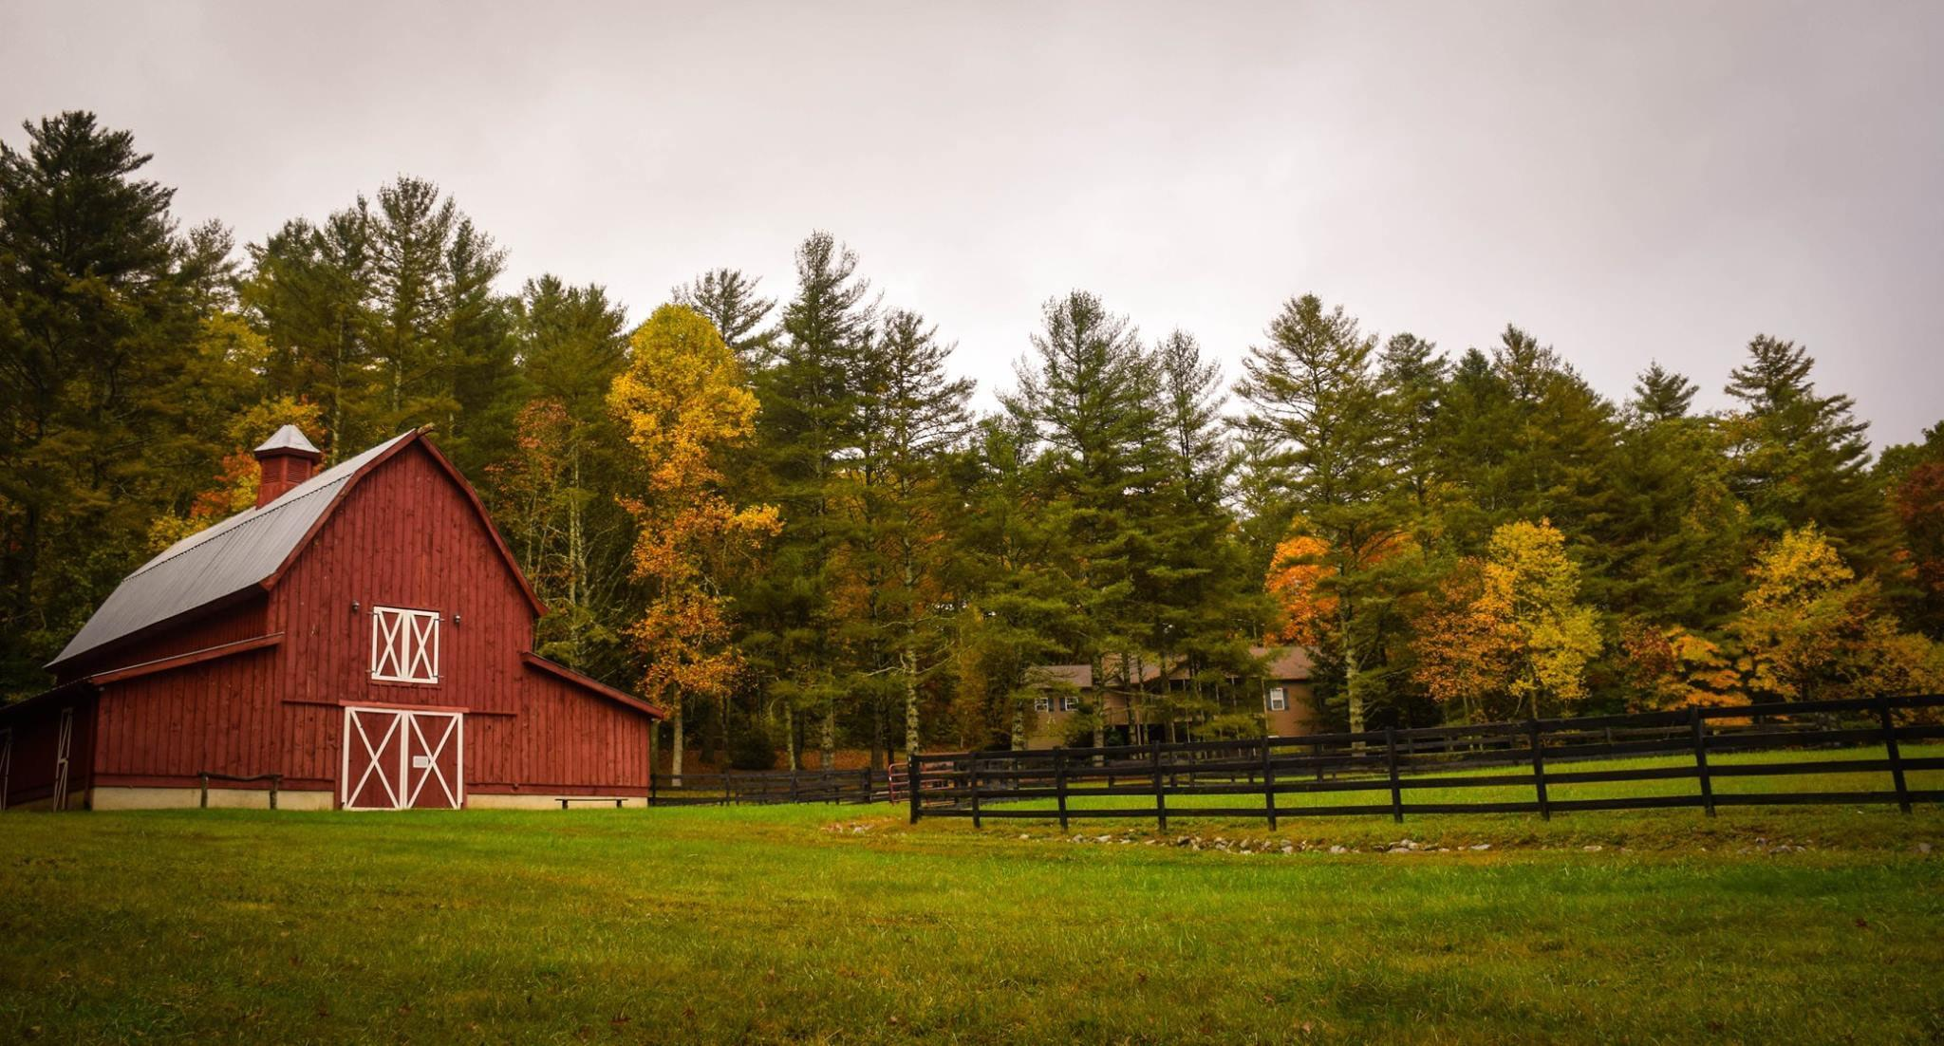
hill top = hilltop

Slide 31
muf fin = muffin

Slide 32
nap kin = napkin

Slide 33
chick en = chicken

Slide 34
chick en s = chickens~K. Pasquel

Slide 35
an im al = animal

Slide 36
an im al s = animals

Slide 37
Text Connection~ Storytime!
A Day At the Farm
Stan and Tim will go to the farm. They will go in a red van.
When they get to the farm, they see a big red barn.
In the barn they see chickens.
The chickens go “Cluck! Cluck!”
The chickens sit on nests. In the nests there are eggs!
There are hills of grass at the farm!
In the grass Stan can see animals. The animals eat grass.
There are gardens at the farm too! Story by K. Pasquel

Slide 38
THANK YOU!
Copyright Slides mania
Do you have any questions?
hello@mail.com
555-111-222
mydomain.com
Phonics words/practice and story
by Karen Pasquel, NBCT, MEd

Slide 39
CREDITS.
Presentation Template: SlidesMania
Images: Unsplash
Fonts used in this presentation: DM Sans and Pompiere

